Slide 1

National Institute of Electronics and Information Technology
Ministry of Electronics and Information Technology, Government of India
Project – Real time Weather Monitoring and Reporting using IoT Devices
Under the guidance and supervision of
Mrs. Banti Das
Scientist “C”
By
Pritam Sutradhar

Slide 2
CONTENTS
Understanding I.O.T
Sensors
Microcontrollers
Other devices and connections
DHT11/DHT22
ESP32
7. Implementation
8. Webpage designing
9. Local Host Server
10. Data Flow
11. Conclusion

Slide 3
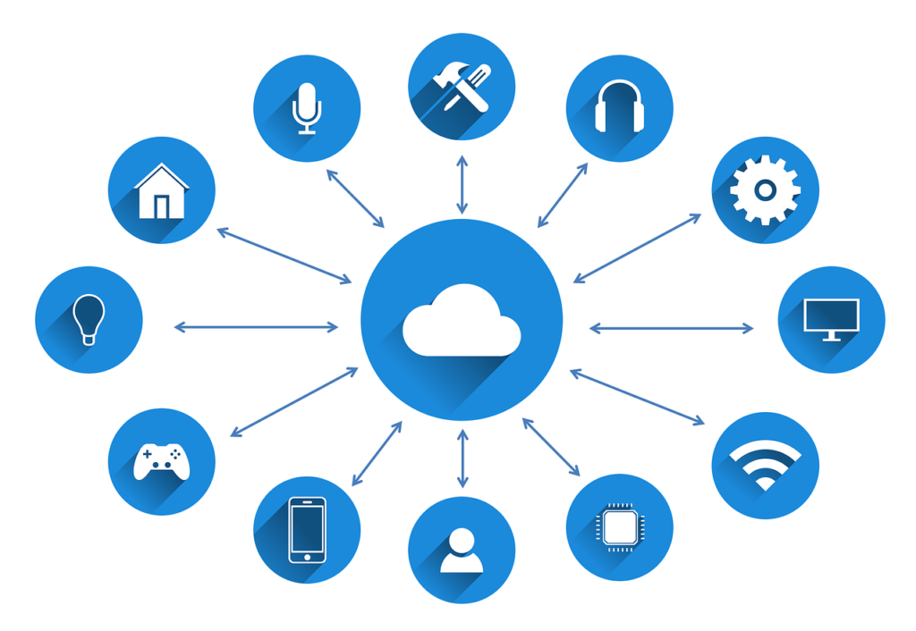
What is IOT(Internet of Things)
Interconnected Devices: IoT connects physical devices for data exchange.
Data Collection: IoT devices gather and analyze data.
Applications: IoT transforms industries with automation and monitoring.
Challenges: Security and interoperability are major issues.
Future Trends: IoT will advance with edge computing and AI.

Slide 4
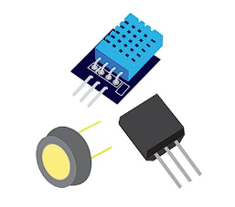
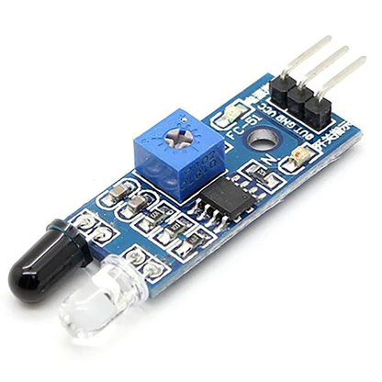
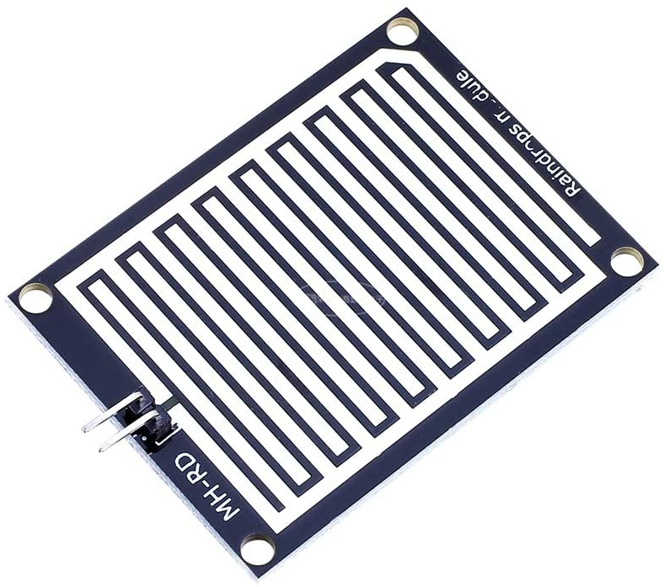
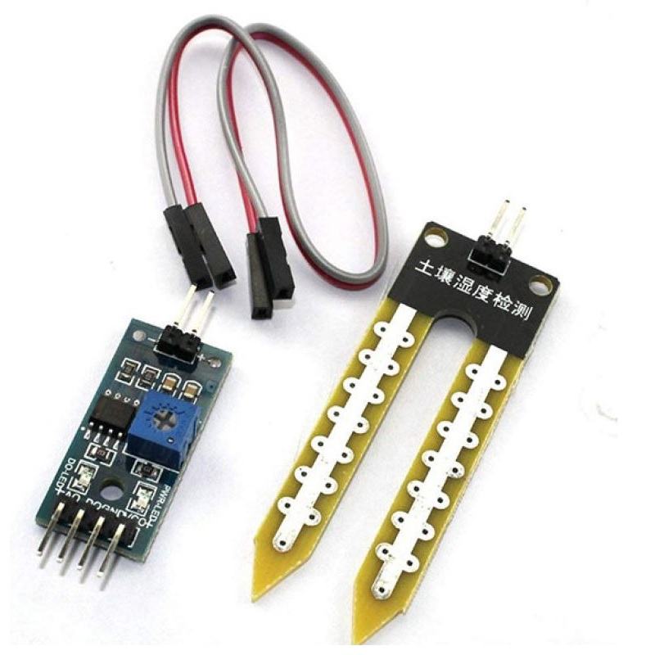
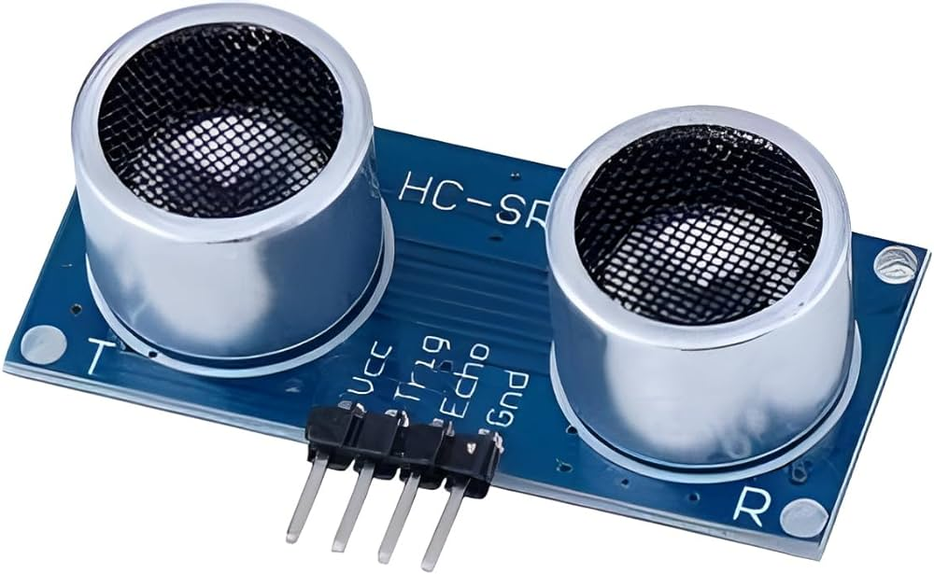
What are Sensors?
A sensor converts physical signals into electrical signals and is part of a larger system providing data to a control system.
It can detect changes in their environment and relay information to electronics.
They are used in everyday objects to measure properties like temperature and pressure.
Some Types of Sensors
IR Sensor
Rain Sensor
Soil Moisture Sensor
Ultrasound Sensor

Slide 5
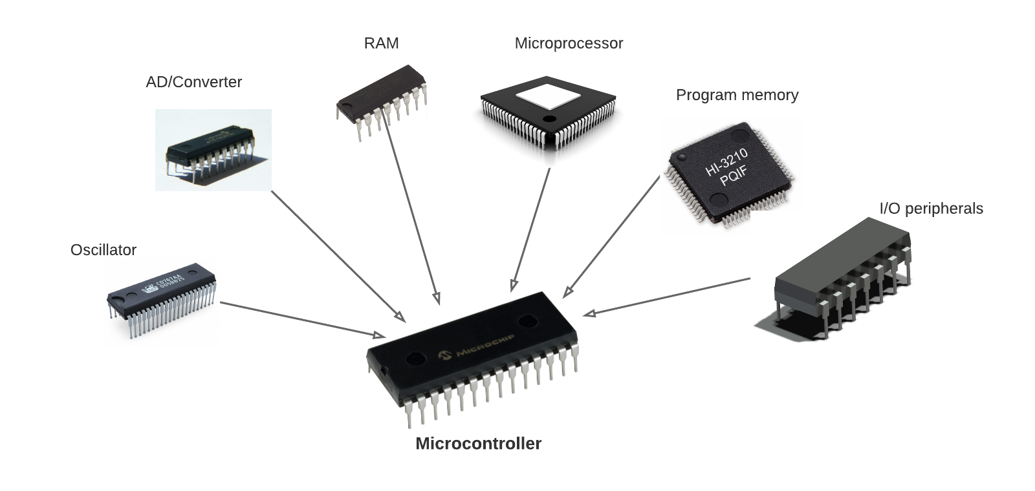

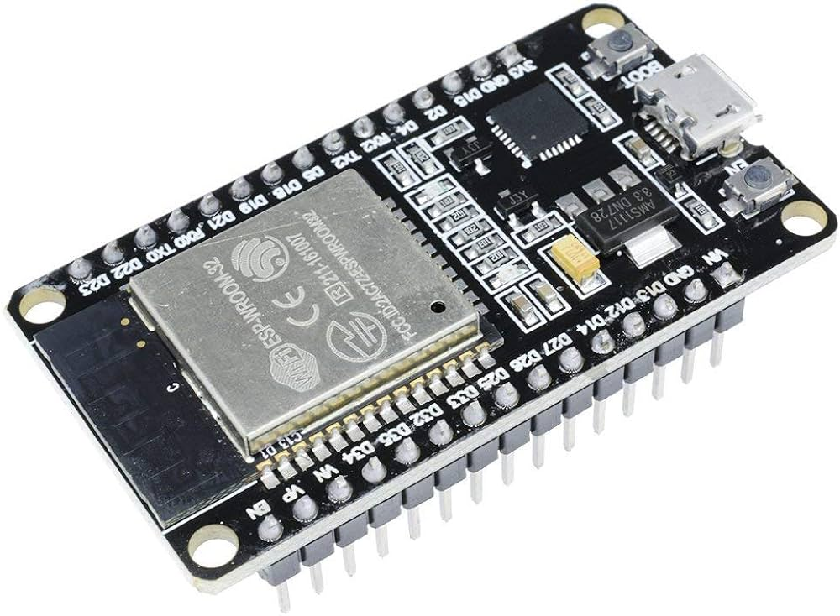
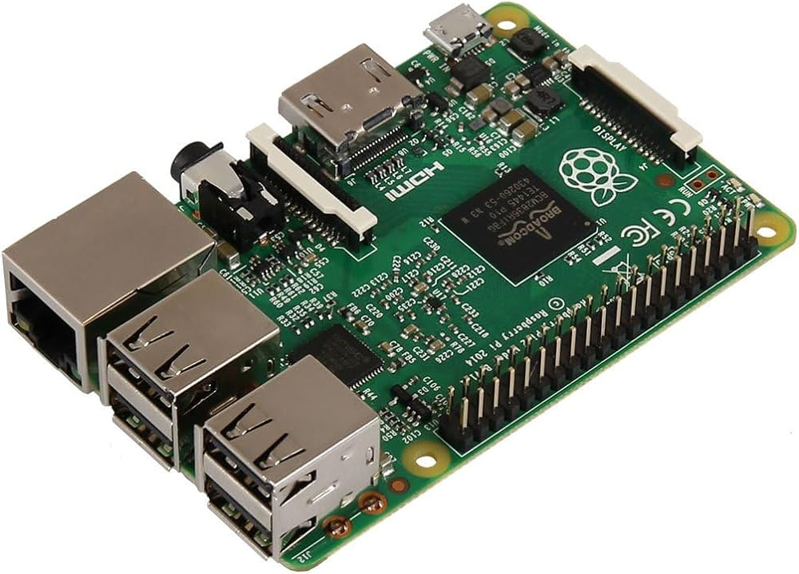
What are Microcontrollers
Arduino UNO
ESP32 WiFi + Bluetooth
Raspberry Pi

Slide 6
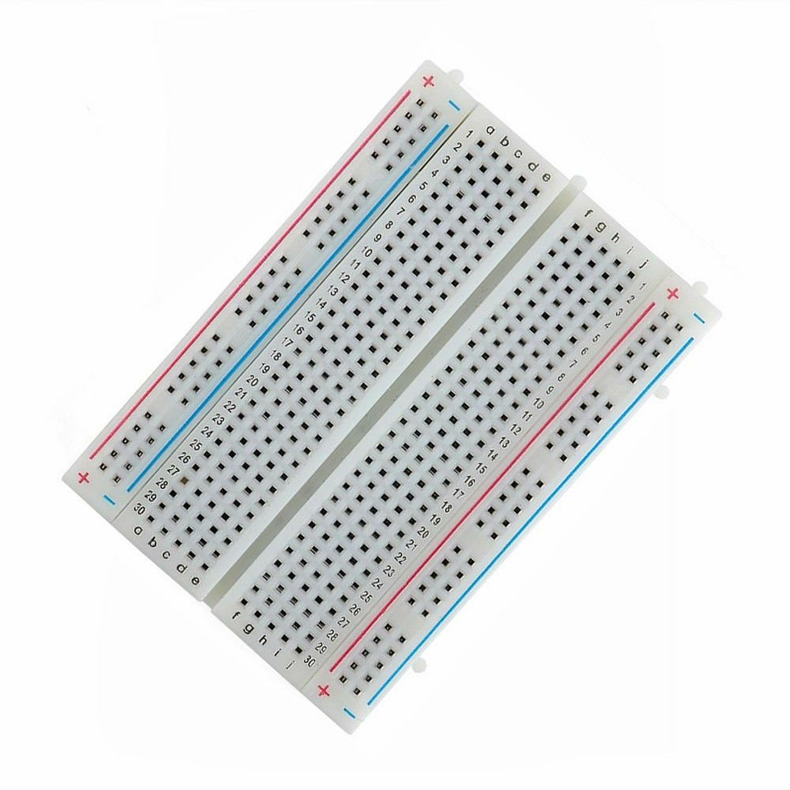
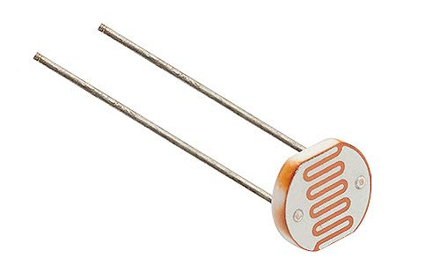
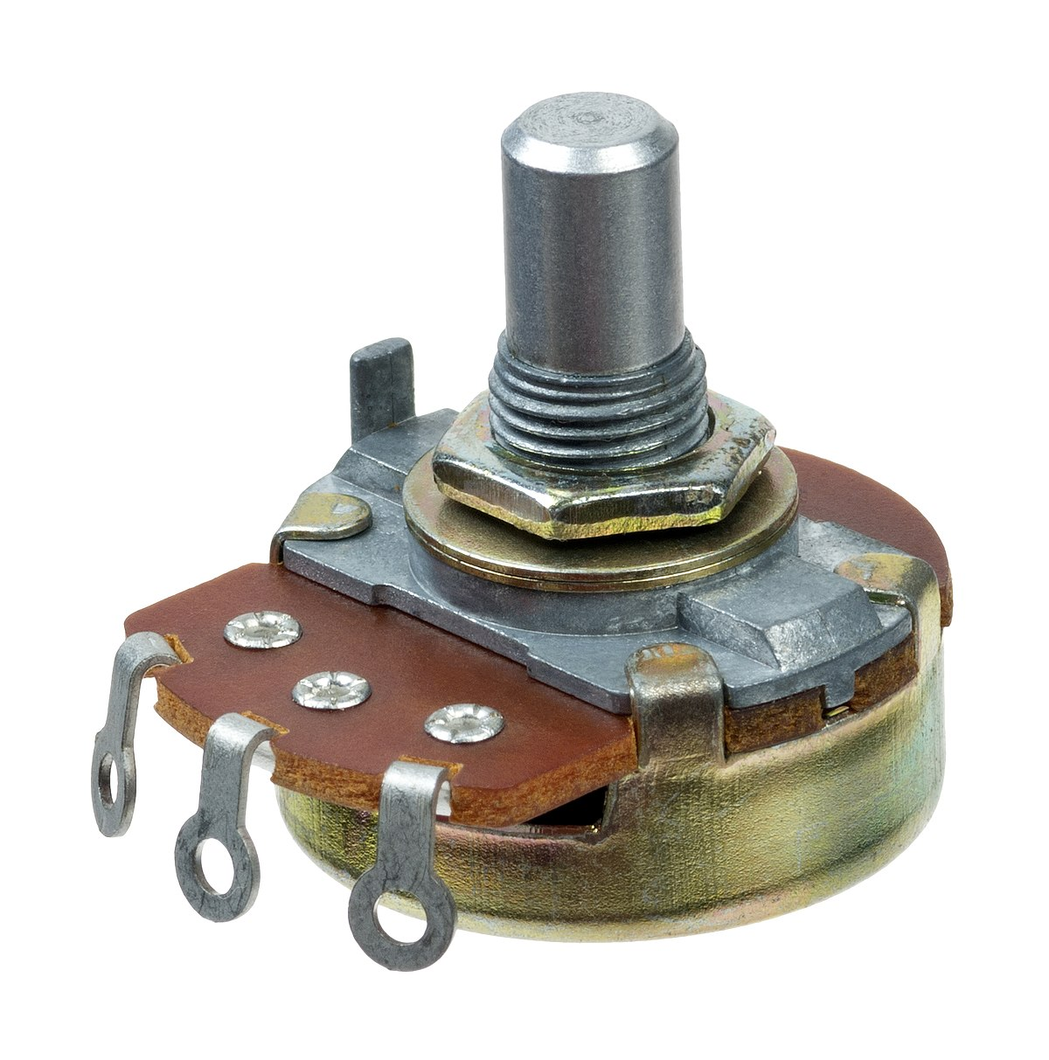
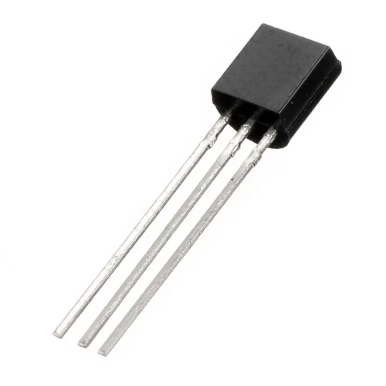
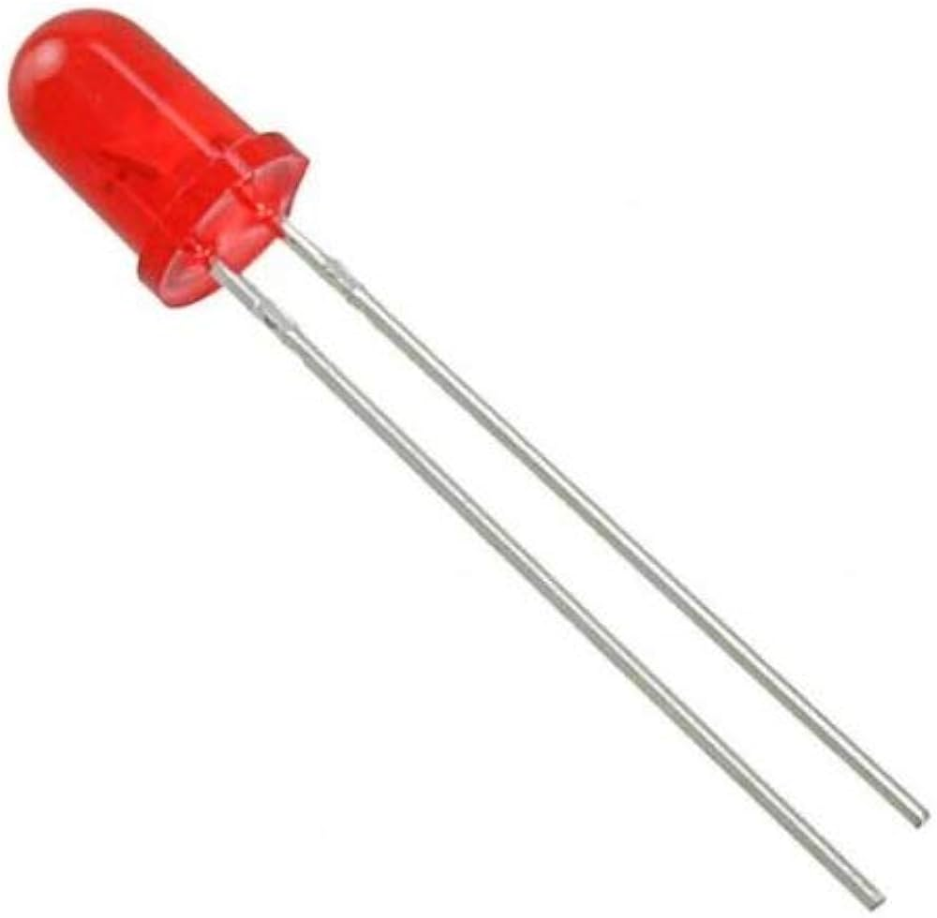
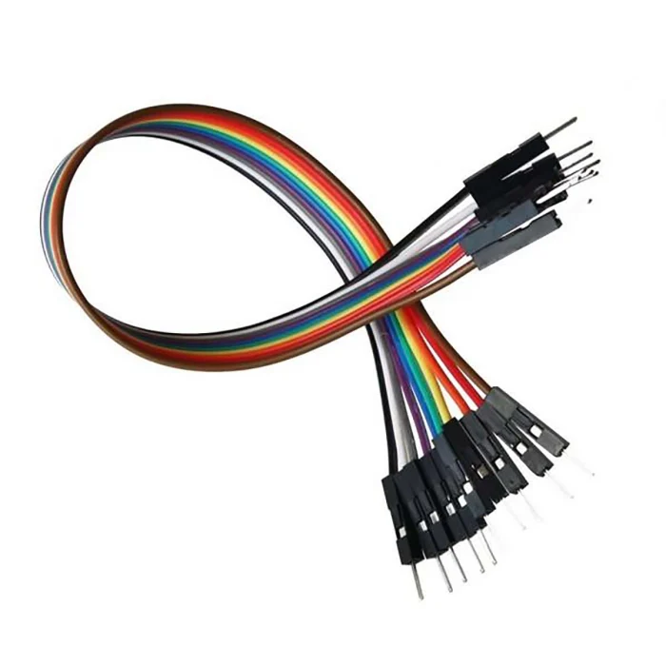
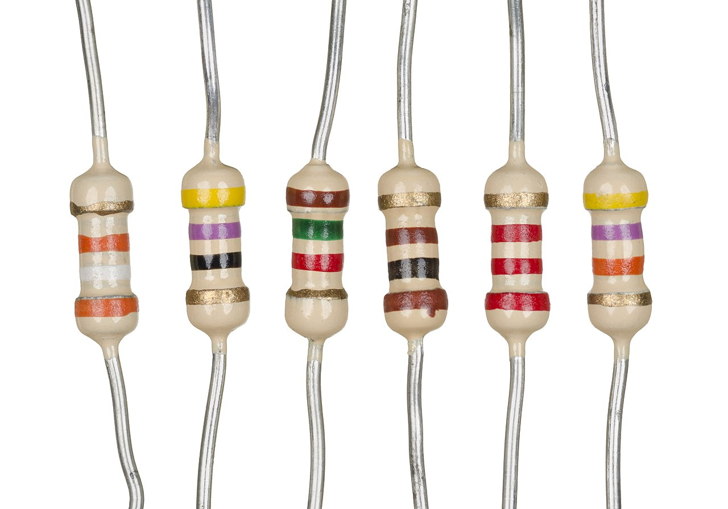
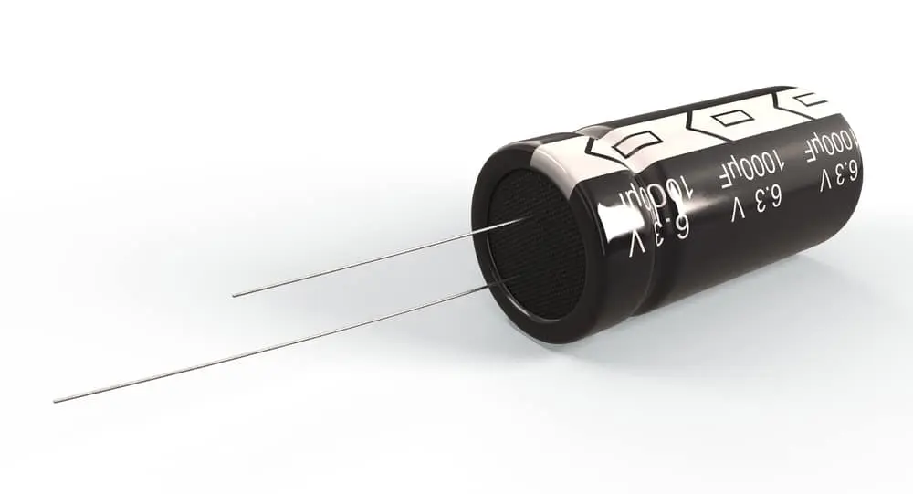
Some Important Devices
Photo Resistor
Potentiometer
Bread Board
Transistor
LED
Jumper wire
Resistors
Capacitor

Slide 7
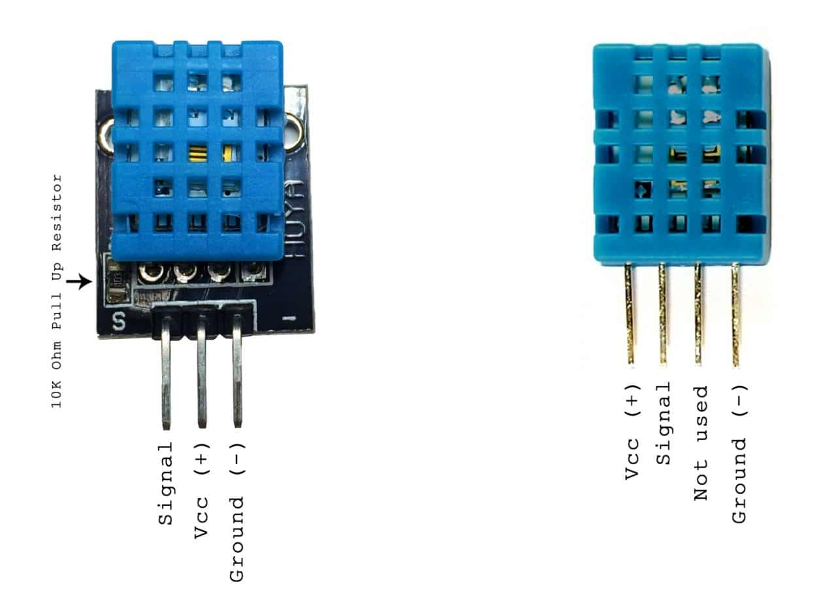
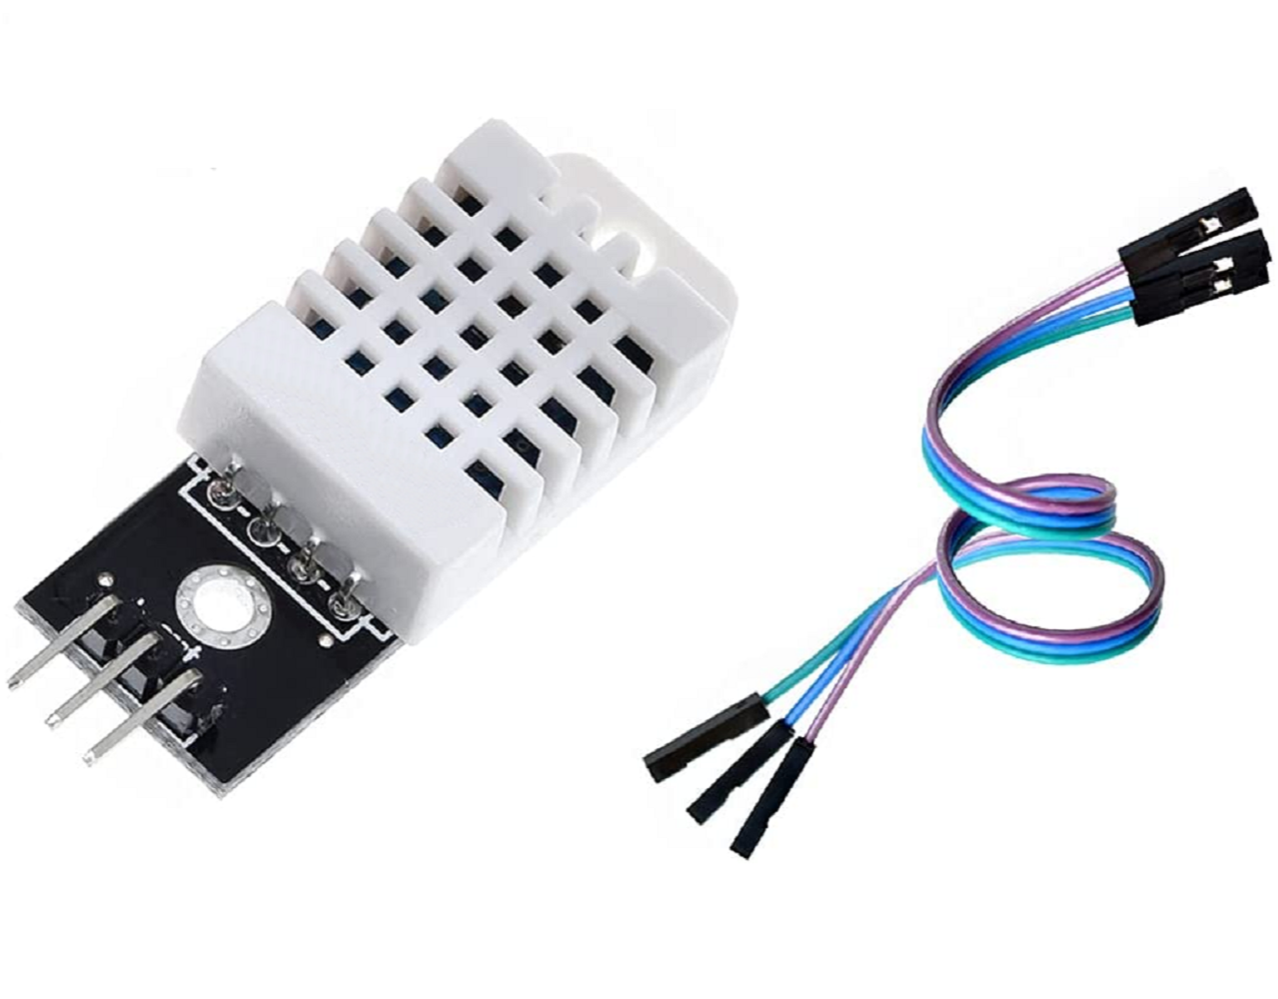
What are DHT11/DHT22 Sensors
The DHT11 sensor is a basic, low-cost digital sensor that measures temperature and humidity.
The DHT11 sensor measures temperature using a thermistor and humidity using a capacitive humidity sensor, then outputs the data digitally.
DHT22 offers higher accuracy and a wider range for both measurements.
DHT11
DHT22

Slide 8
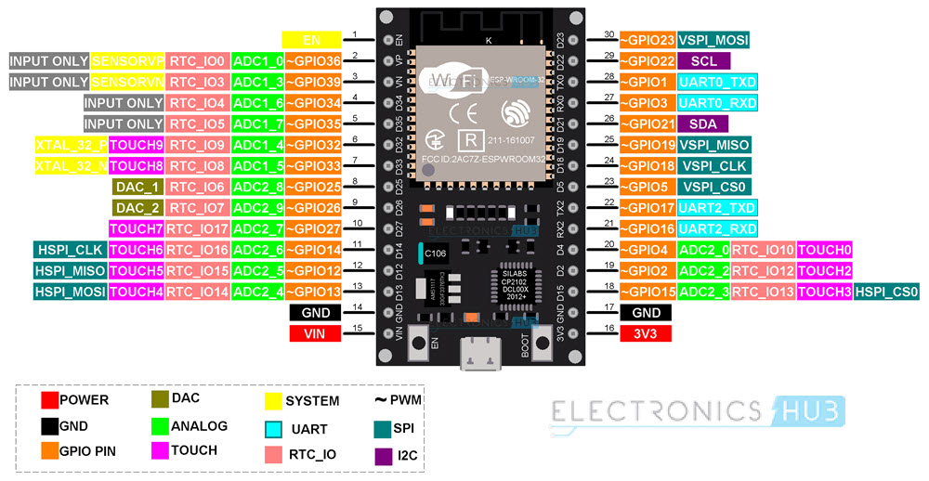
ESP32 WROOM-32

Slide 9
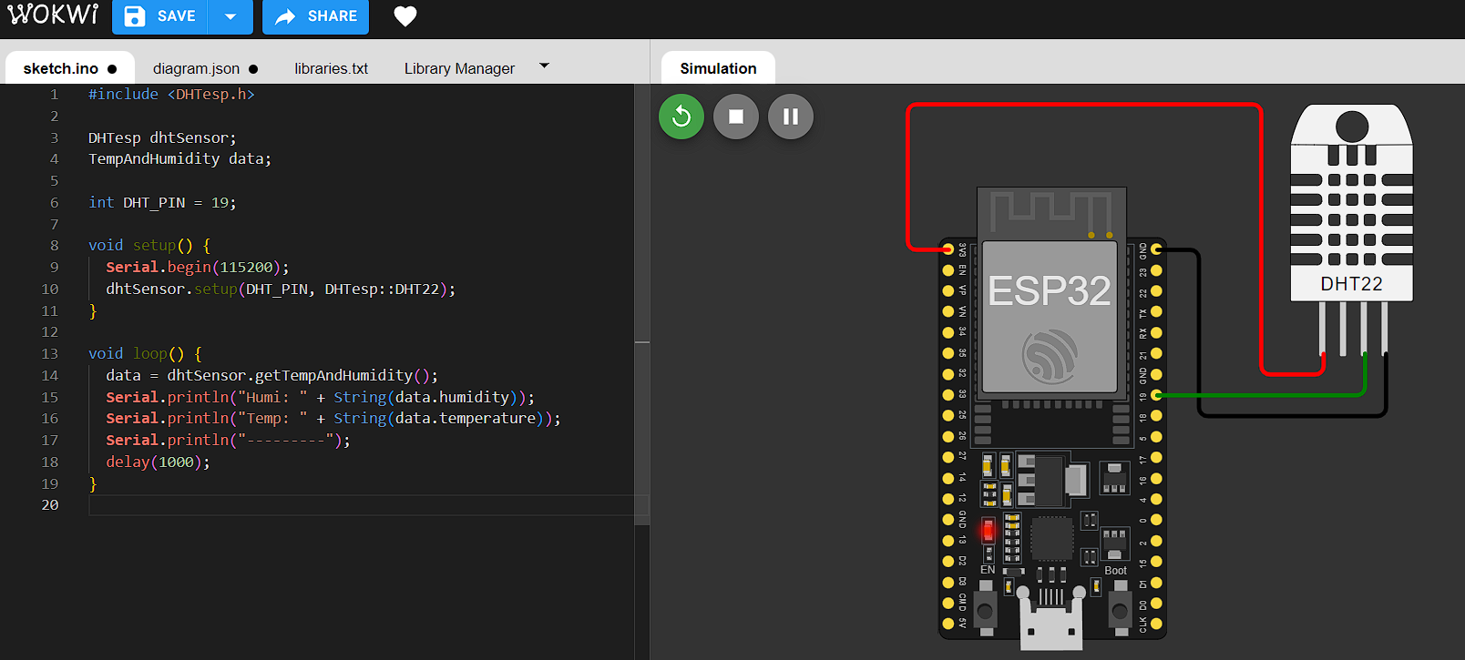
IMPLEMENTATION
on WOKWI simulator

Slide 10
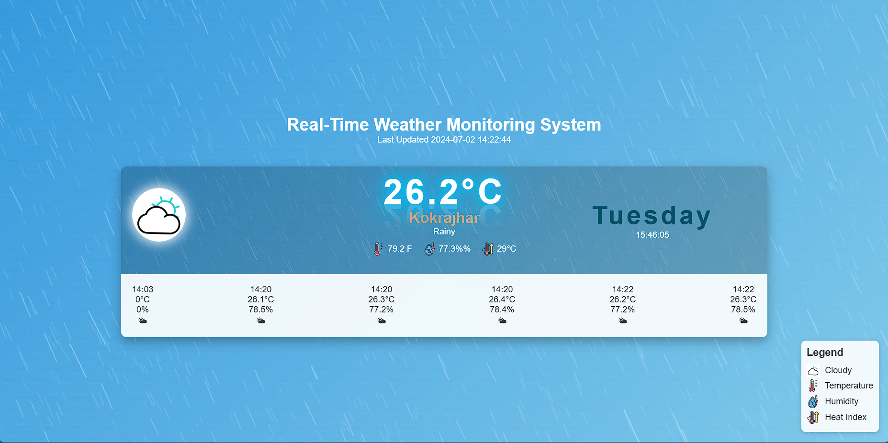
WEB INTERFACE

Slide 11
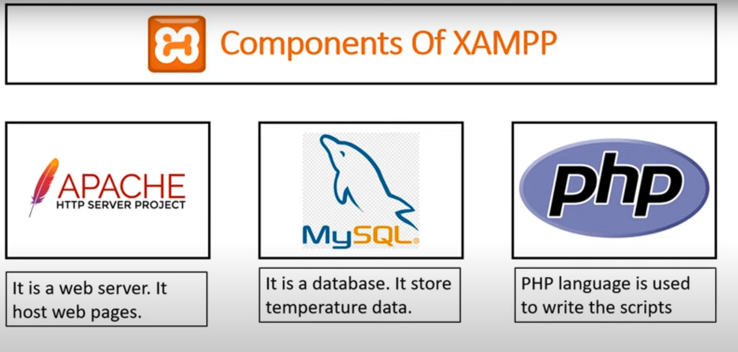
LOCAL HOST SERVER

Slide 12
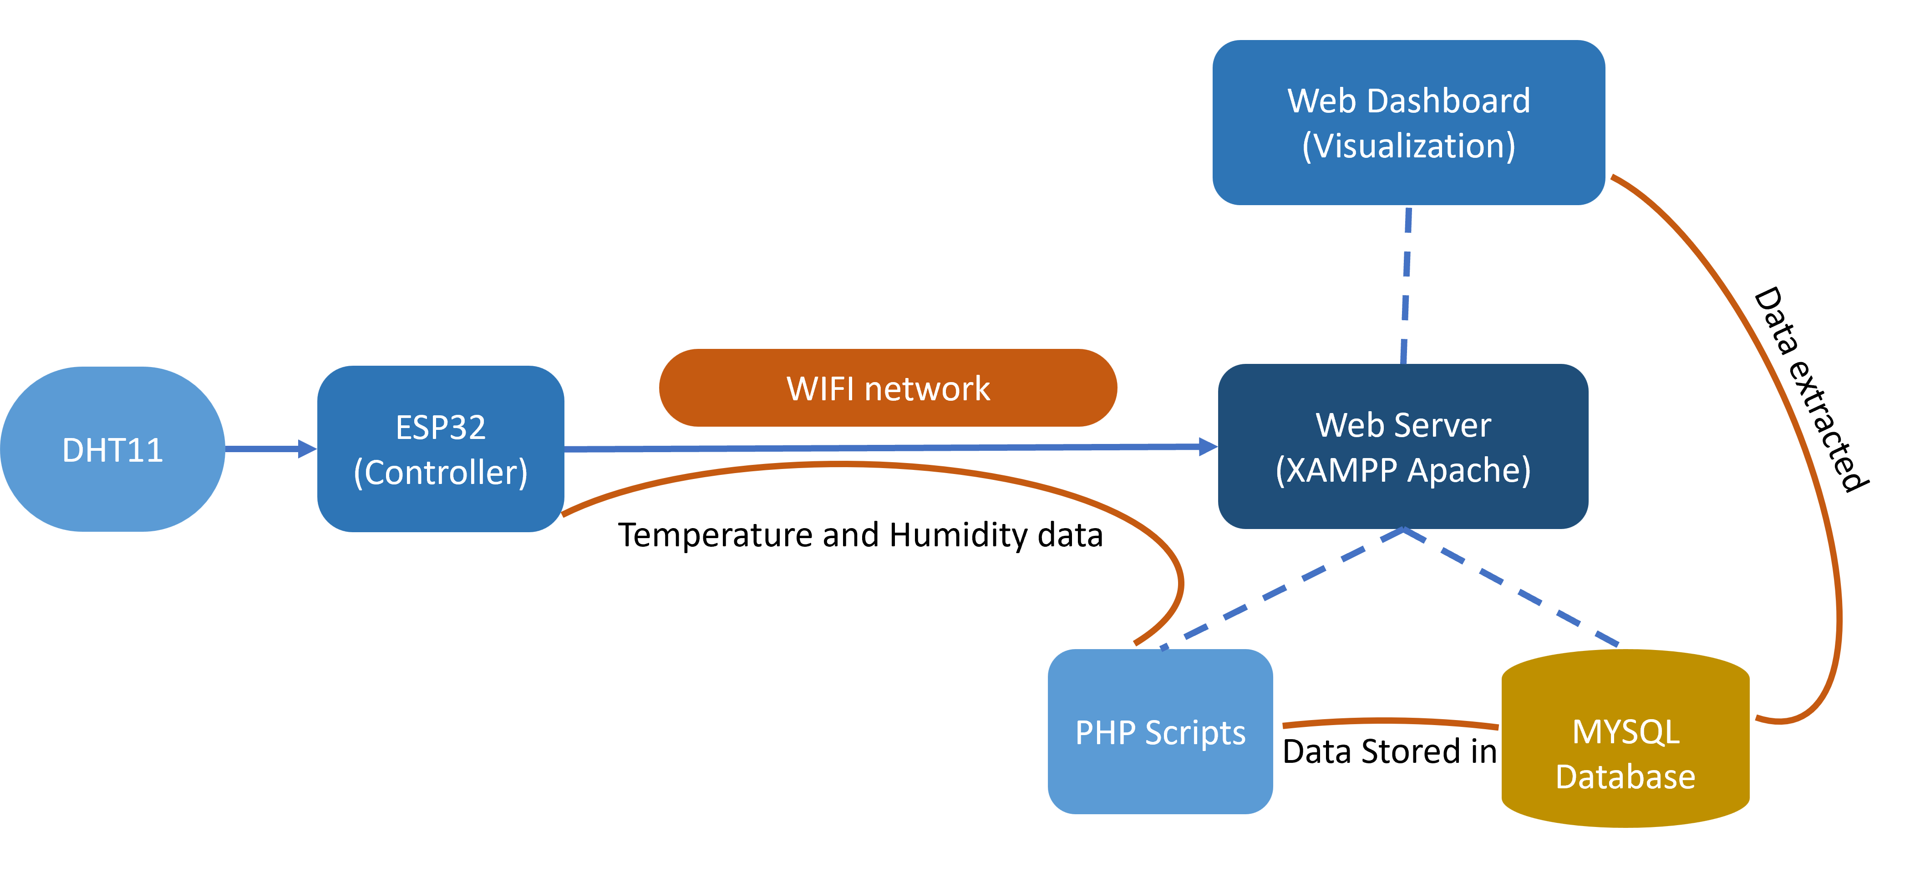
DATA FLOW

Slide 13
CONCLUSION and FUTURE SCOPE
In conclusion, We have successfully developed and implemented a real-time temperature and humidity monitoring system utilizing the ESP32 microcontroller and the DHT11 sensor. This project demonstrates the effective integration of IoT components to provide accurate environmental data in real-time. Moving forward, I aim to expand the system by incorporating additional sensors to monitor a broader spectrum of environmental parameters. This enhancement will not only make the system more versatile and dynamic but also increase its applicability in various domains such as smart homes, industrial automation, and environmental monitoring. These future improvements will ensure the system's capability to deliver more comprehensive and actionable data.

